Slide 1
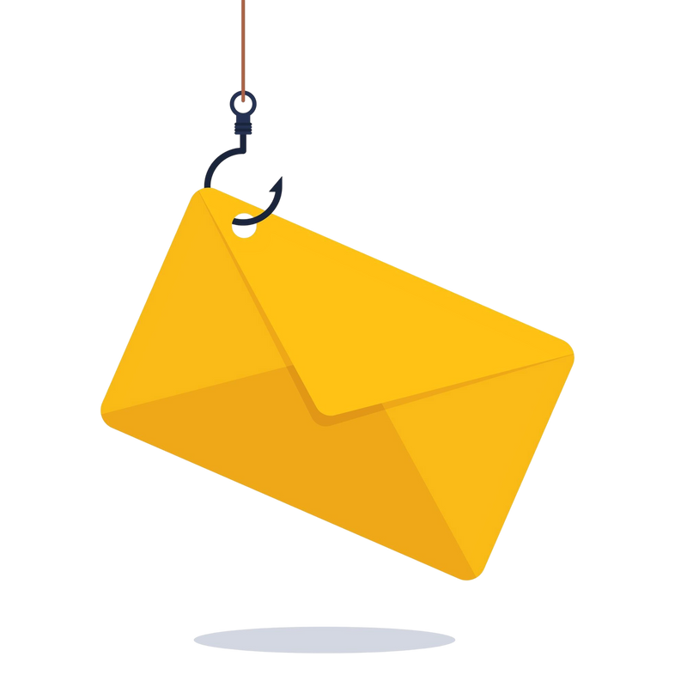

Phishing Awareness Training
-Don’t Take the Bait!
Learn to Spot, Stop, and Report Phishing Attacks.
Welcome! Today, we’ll dive into the world of phishing—one of the most common cyber threats. By the end, you’ll be equipped to identify and avoid these traps

Slide 2

What is Phishing ?
Definition: Fraudulent attempts to steal sensitive data.
Goal: Credentials, financial info, or malware installation.
"Phishing is like fishing—attackers cast a wide net, hoping someone bites. But instead of fish, they’re after your data."

Slide 3
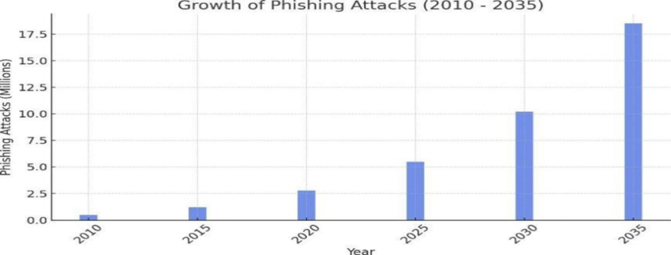


Why Should You Care?
"Phishing isn’t just an IT problem. A single click can compromise your personal data, company secrets, or even your bank account."

Slide 4
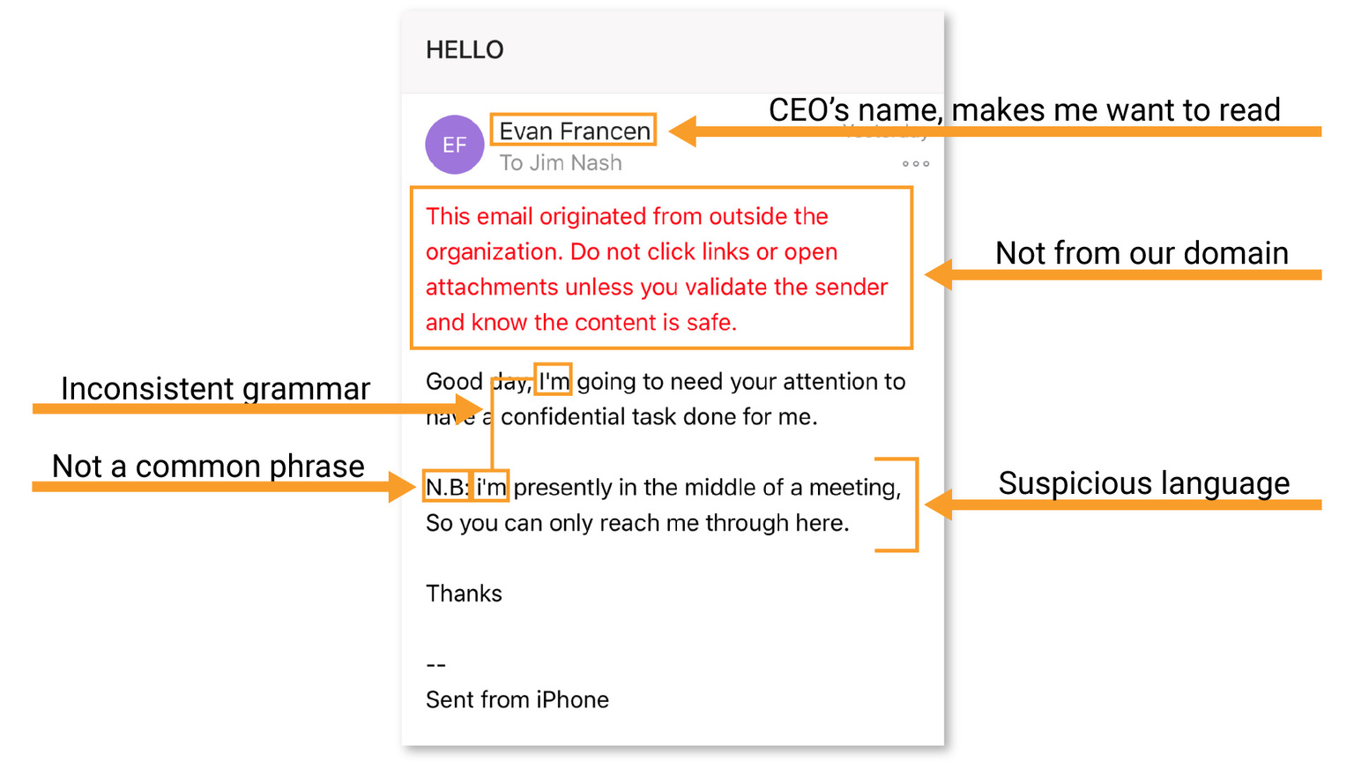
Anatomy of a Phishing Email
"Let’s dissect a phishing email. Notice the urgency, generic greeting, and mismatched sender address. Hover over links to reveal the true URL!"

Slide 5

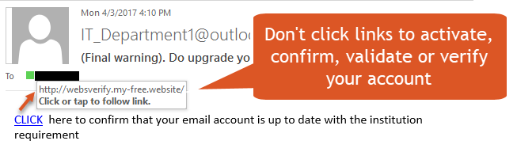
Fake Website Red Flags
"Attackers clone websites. Always check the URL and look for HTTPS. No padlock? No trust!"

Slide 6
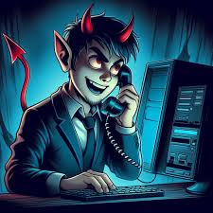
Social Engineering Tactics
"Attackers manipulate trust. If someone calls asking for your password, it’s a scam—even if they sound convincing."

Slide 7
Phishing Email Quiz
Question 1:
Which of the following is a common red flag in a phishing email?
A) The email contains a generic greeting like "Dear Customer."
B) The sender's email address is from a legitimate domain (e.g., @microsoft.com).
C) The email includes a link to a well-known website (e.g., www.paypal.com).
D) The email is sent during business hours.

Slide 8
Answer: A) The email contains a generic greeting like "Dear Customer."
Explanation:
Phishing emails often use generic greetings because they don’t know your name. Legitimate companies usually address you by name.

Slide 9
Phishing Email Quiz
Question 2:
What should you do if you receive an email asking you to click a link to verify your account details?
A) Click the link and enter your details.
B) Forward the email to your IT security team or report it as phishing.
C) Reply to the email asking for more information.
D) Ignore the email but keep it in your inbox.

Slide 10
Answer: B) Forward the email to your IT security team or report it as phishing.
Explanation:
Never click on suspicious links or provide personal information. Reporting it helps protect others.

Slide 11
Phishing Email Quiz
Question 3:
Which of the following is an example of a phishing technique?
A) Sending a fake invoice from a known vendor.
B) Calling you to confirm your identity.
C) Posting a job advertisement on LinkedIn.
D) Sending a newsletter from a subscribed service.

Slide 12
Answer: A) Sending a fake invoice from a known vendor.
Explanation:
Attackers often impersonate trusted vendors to trick recipients into paying fraudulent invoices.

Slide 13
Phishing Email Quiz
Question 4:
How can you verify if a link in an email is safe without clicking it?
A) Hover over the link to see the actual URL.
B) Copy and paste the link into a search engine.
C) Ask a colleague if they received the same email.
D) Both A and B.

Slide 14
Answer: D) Both A and B.
Explanation:
Hovering reveals the true destination, and searching the URL can reveal if it’s associated with scams.

Slide 15
Phishing Email Quiz
Question 5:
What is "spear phishing"?
A) A type of fishing using a spear.
B) A targeted phishing attack aimed at a specific individual or organization.
C) A phishing email sent to millions of recipients.
D) A phishing attack that only uses phone calls.

Slide 16
Answer: B) A targeted phishing attack aimed at a specific individual or organization.
Explanation:
Spear phishing is highly personalized and often uses information about the target to appear legitimate.

Slide 17

Best Practices
Enable Multi-Factor Authentication (MFA)
Verify Suspicious Requests
Report Phishing Attempts
Hover Before You Click
Use Email Filtering Tools
Keep Software Updated
Stay Updated

Slide 18


BREAKING: TechCorp Loses $2.4M in Sophisticated CEO Fraud Scam
Employees Tricked by Fake "Urgent" Wire Transfer Request
Attackers impersonated the CFO via a spoofed email domain.
Funds were transferred to offshore accounts before detection.
Incident underscores need for stricter payment verification protocols.
This headline can serve as a real-world example to emphasize the consequences of phishing.

Slide 19
*Mock Email*
Subject: Urgent: Your Account Requires Immediate Verification
From: "IT Support Team" support@yourcompany.xyz (Note: Spoofed domain)
To: [Recipient's Email]
Date: [Current Date]
Body:
Dear Employee,
Our records indicate that your email account has exceeded its storage limit. To avoid service disruption, you must verify your account within 24 hours by clicking the link below:
🔗 Verify Account Now (Hover to reveal: Actual URL is "http://malicious-phish-site.com")
Failure to act will result in account suspension.
Thank you,
IT Support Team
Your Company Name (Note: Fake branding)
*Would you click, delete, or report this email?

Slide 20

Resources
PhishTool
VirusTotal
Email Header Analyzer (MxToolbox)
Google’s Gmail Message Header Analyzer
URLScan.io
PhishTank

Slide 21

Thank you!
Do you have any questions?
Try these tools and share this training with your team!

